Slide 1
How do we govern AI and machine learning?
By Christopher Proudfoot

Slide 2

The digital welfare state
Automation of social protection or “welfare” through AI and data driven technologies.

Slide 3


Digital welfare is presented with the claims that it would
Be more efficient
Saving money
Personnel reductions
Encouraging individual autonomy
Make services more accessible
Root out fraudulent welfare claims

Slide 4
Often however the digitization of welfare has been accompanied by
Reduction in overall welfare budget.
A narrowing of the beneficiary pool.
The elimination of some services.
Digital inequality.
A complete reversal of traditional notion that the state should be accountable to the individual.

Slide 5
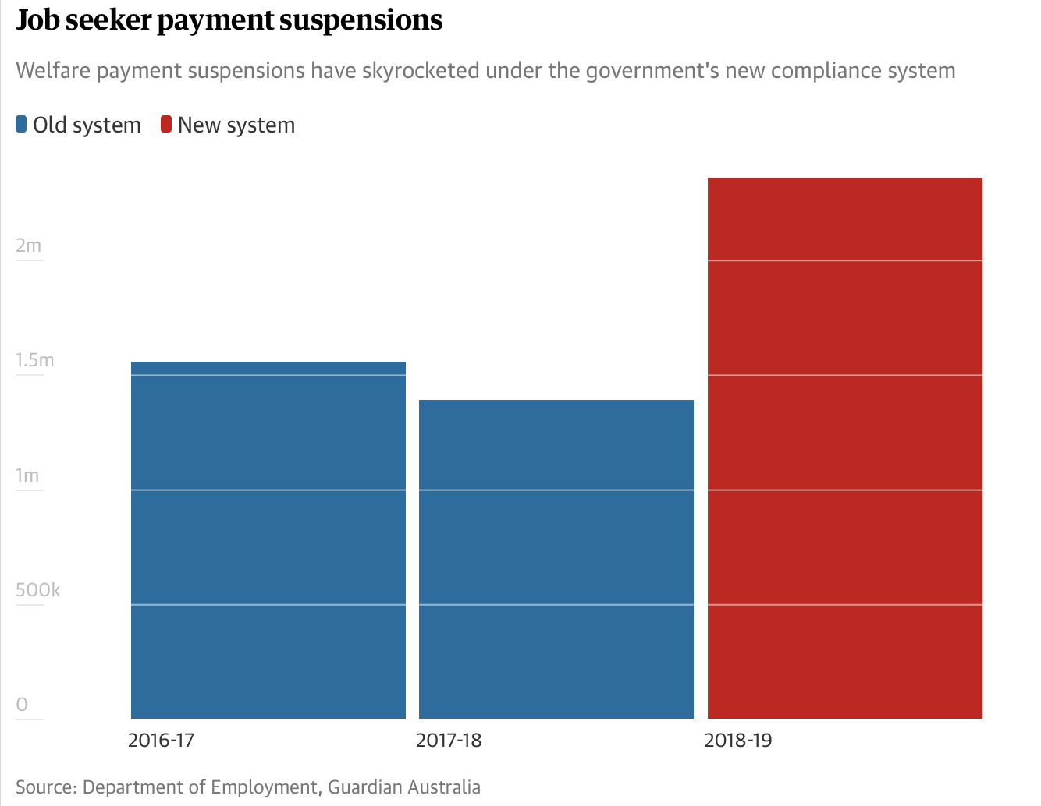
Australia
Australia is using automation to suspend millions of welfare payments.
The suspensions can occur without notice.
75% of the time the payments were suspended when the recipient was not at fault.

Slide 6
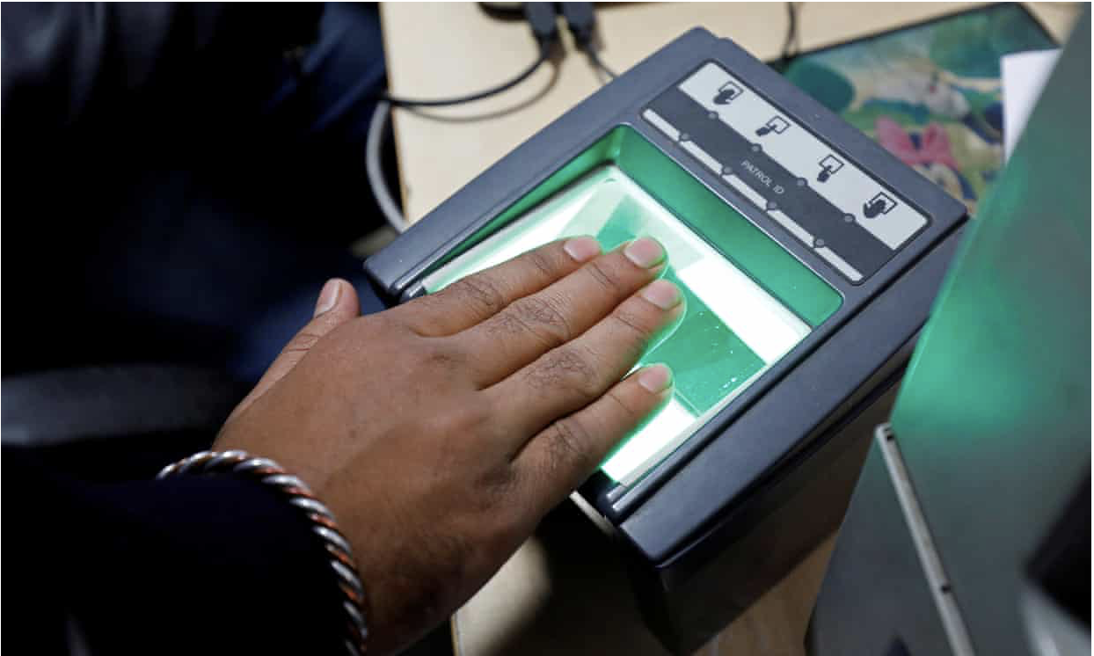
India
In India the government has issued a 12-digit unique identification number to all residents known as Aadhaar.
The residents biometric profile is link to the number.
Aadhaar is used to verify the identity of recipients of benefits and subsidies.
A resident Motka Manjhi had his subsistence rations stopped due to an error where his biometrics were not recognised.
He was forced to skip meals, he grew thin and unfortunately died.

Slide 7

Although these technologies are presented as scientific and neutral, they can reflect values and assumptions that are far removed from the principles of human rights.

Slide 8
Ways to govern digital technologies and make them work for social protection
Legal framework must be in place in systems that deal with people's basic human needs.
New technologies must reflect the values of human rights and treat any user as a right holder and not just an applicant.
To avoid errors and to increase accountability it is vital that everyone from CEO to development are involved in implementing new technologies.
Systems must have transparency, this will open them up to scrutiny which will help detect overlooked issues.
Digital equality is important now more than ever due to technologies moving from ‘digital by default’ to ‘digital only’. A lack of digital literacy puts people at a disadvantage.

Slide 9

As with many industaries there is great advantages to be had with using such technologies as AI, however when dealing with people's basic human needs there must not be any shortcomings as people may suffer.

